Slide 1

List

Slide 2
Create and extracting the character
my_list = ['p', 'r', 'o', 'b', 'e']
# first item
print(my_list[0]) # p
# third item
print(my_list[2]) # o
# fifth item
print(my_list[4]) # e

Slide 3
List
# Nested List
n_list = ["Happy", [2, 0, 1, 5]]
# Nested indexing
print(n_list[0][1])
print(n_list[1][3])
# Error! Only integer can be used for indexing
print(my_list[4.0])

Slide 4
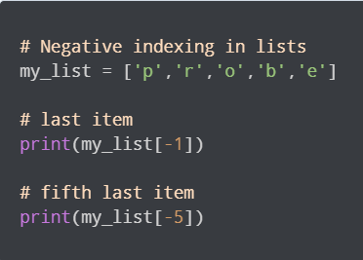

Slide 5
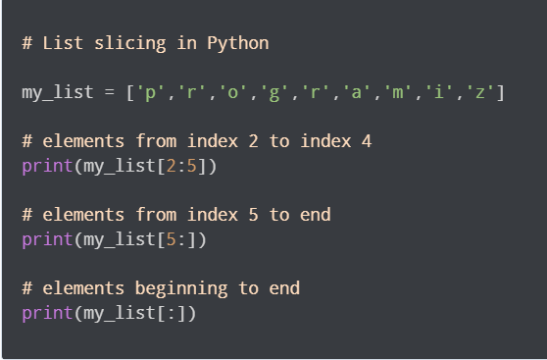
List Slicing in Python

Slide 6
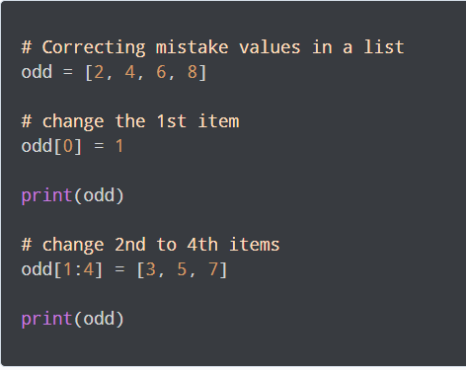
Changing the item value

Slide 7
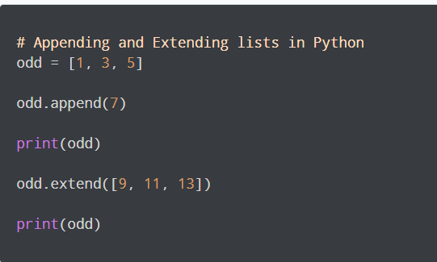
Appending and Extending

Slide 8
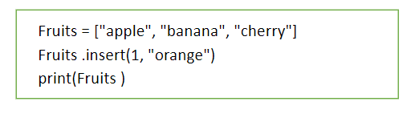
Insert the item in the list to particular index

Slide 9
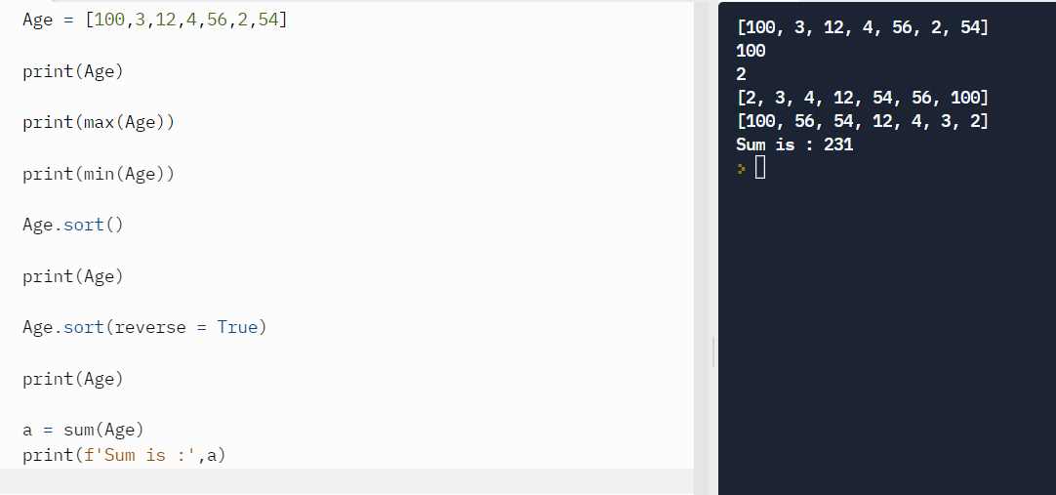
List of numbers

Slide 10
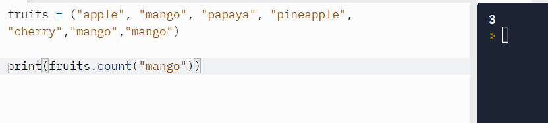
count
Returns how many times item is repeated.

Slide 11
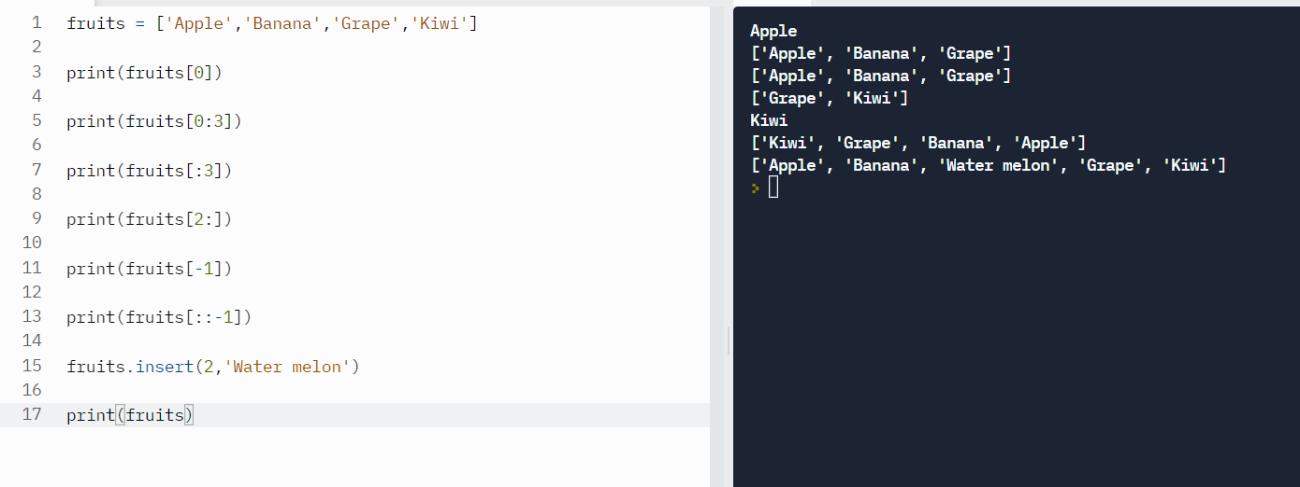
Extracting items from the list

